Slide 1


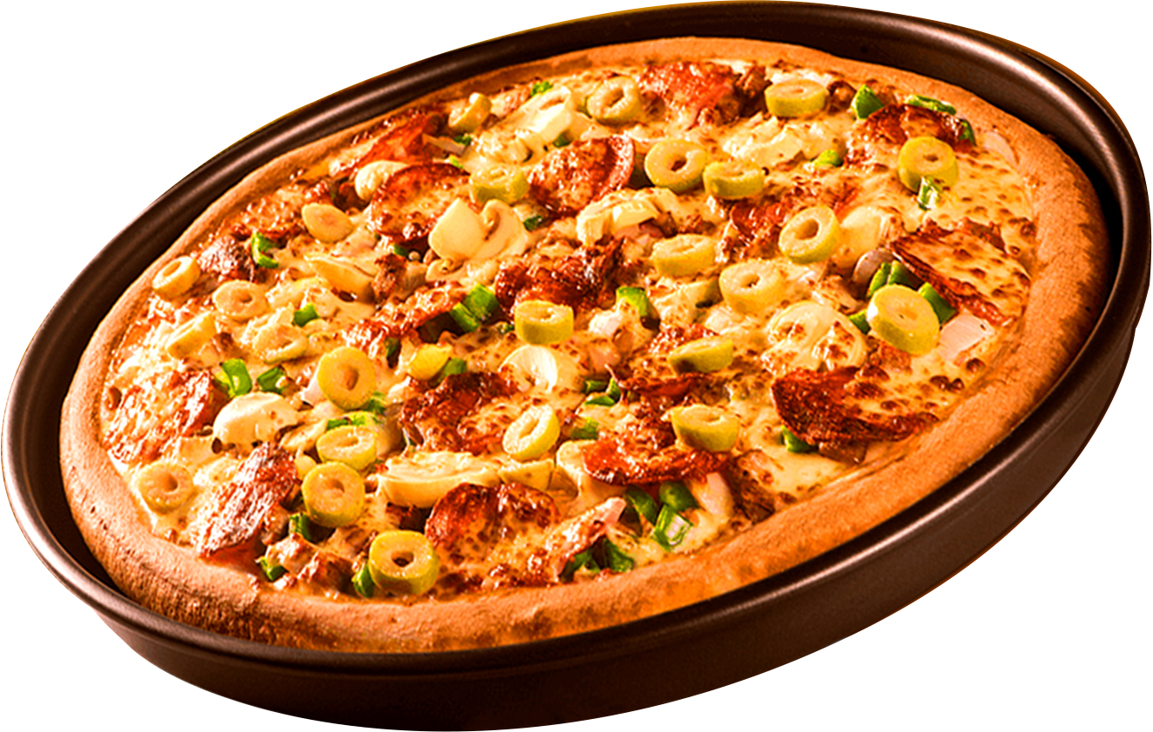
Where Every Slice is a Taste of Perfection
PIZZA RESTRO - SALES REPORT

Slide 2


A SLICE OF SUCCESS
Our Passion for Pizza
Let's dive into Pizza Restro’s sales performance. This report analyzes key metrics, celebrates wins, and explores strategies for future growth.

Slide 3
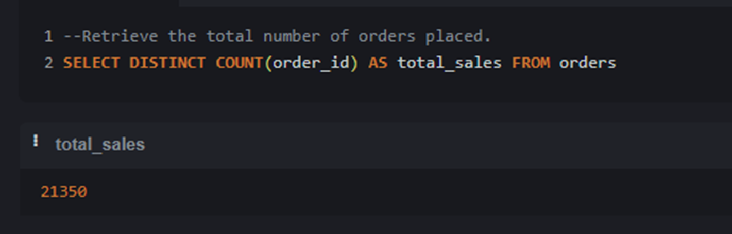
RETRIEVE THE TOTAL NUMBER OF ORDERS PLACED.
Select DISTINCT count(order_id) as total_sales from orders

Slide 4
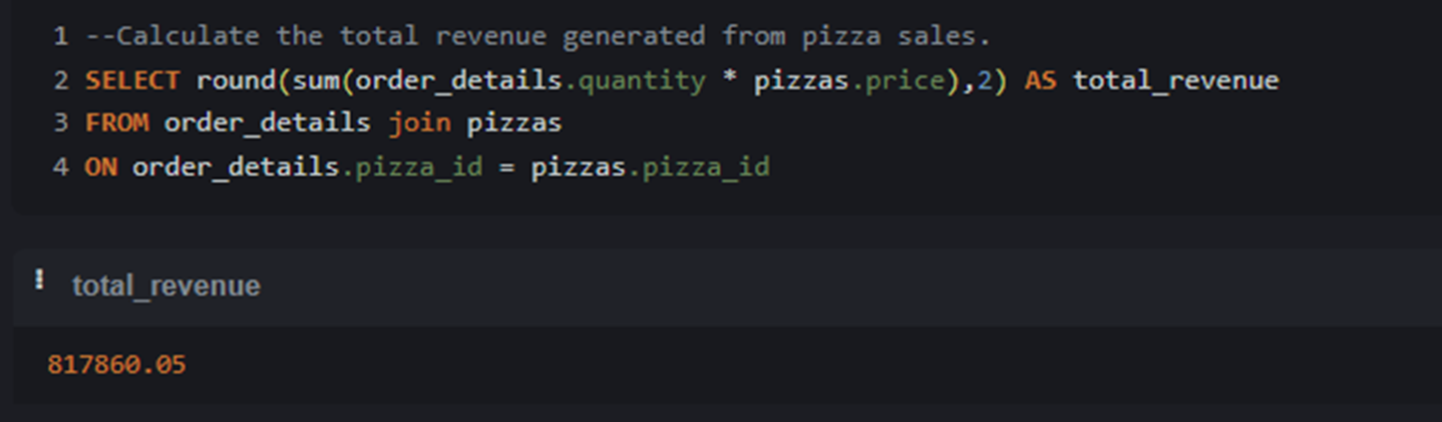
CALCULATE THE TOTAL REVENUE GENERATED FROM PIZZA SALES.
SELECT round(sum(order_details.quantity * pizzas.price),2) as total_revenue
from order_details join pizzas
on order_details.pizza_id = pizzas.pizza_id

Slide 5
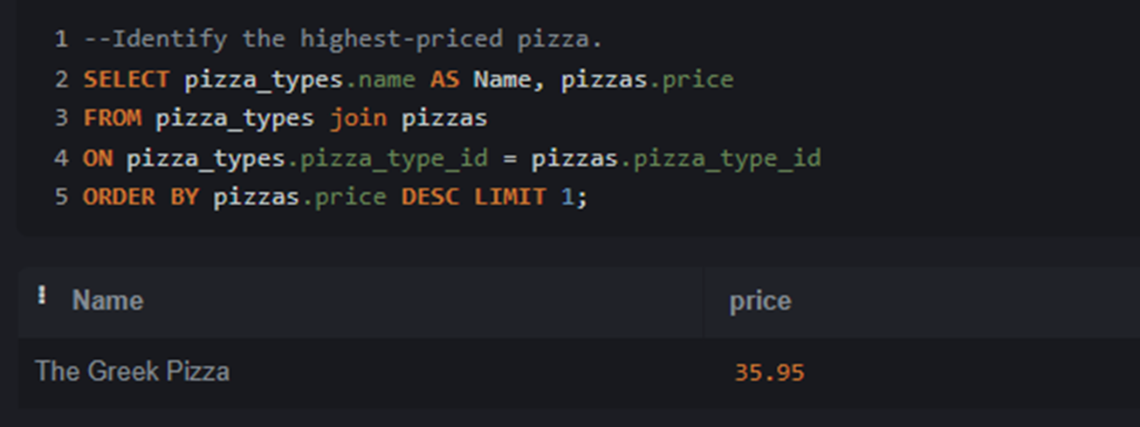
IDENTIFY THE HIGHEST-PRICED PIZZA.
SELECT pizza_types.name as Name, pizzas.price
from pizza_types join pizzas
on pizza_types.pizza_type_id = pizzas.pizza_type_id
order by pizzas.price desc Limit 1;

Slide 6
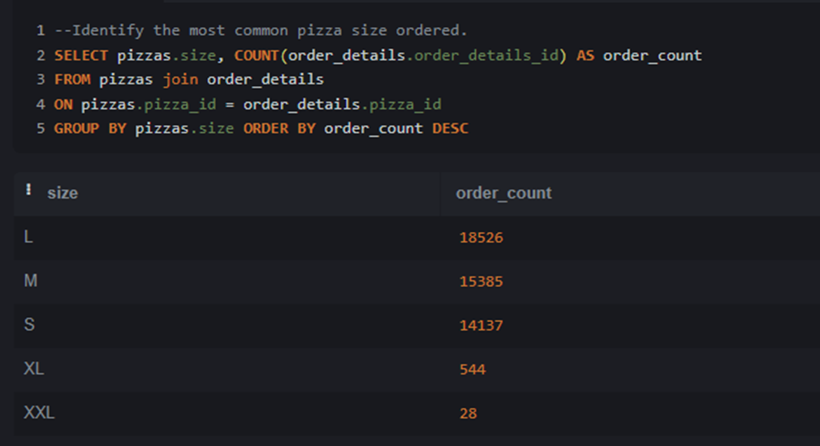
IDENTIFY THE MOST COMMON PIZZA SIZE ORDERED.
select pizzas.size, count(order_details.order_details_id) as order_count
from pizzas join order_details
on pizzas.pizza_id = order_details.pizza_id
group by pizzas.size order by order_count desc

Slide 7
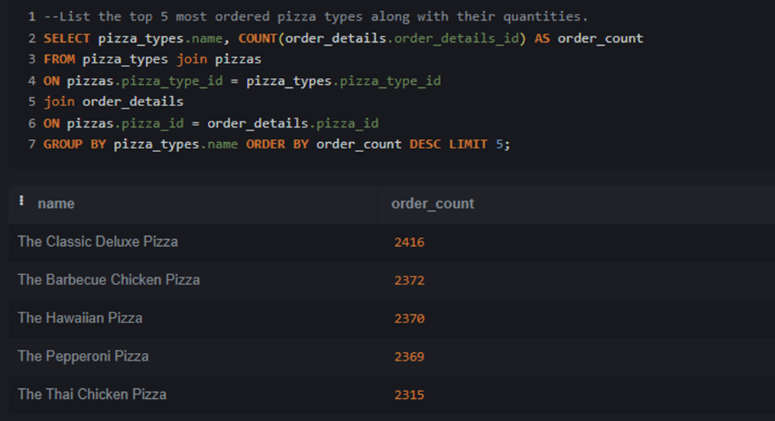
LIST THE TOP 5 MOST ORDERED PIZZA TYPES ALONG WITH THEIR QUANTITIES.
select pizza_types.name, count(order_details.order_details_id) as order_count
from pizza_types join pizzas on pizzas.pizza_type_id = pizza_types.pizza_type_id
join order_details on pizzas.pizza_id = order_details.pizza_id
group by pizza_types.name order by order_count desc limit 5

Slide 8
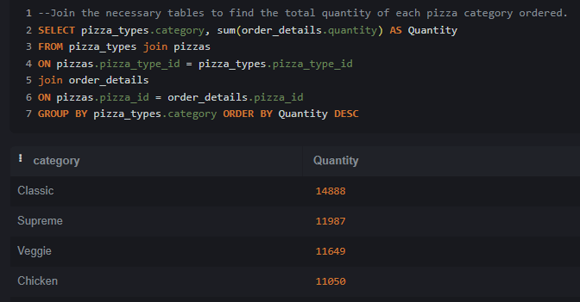
JOIN THE NECESSARY TABLES TO FIND THE TOTAL QUANTITY OF EACH PIZZA CATEGORY ORDERED.
select pizza_types.category, sum(order_details.quantity) as Quantity
from pizza_types join pizzas on pizzas.pizza_type_id = pizza_types.pizza_type_id
join order_details on pizzas.pizza_id = order_details.pizza_id
group by pizza_types.category order by Quantity desc

Slide 9
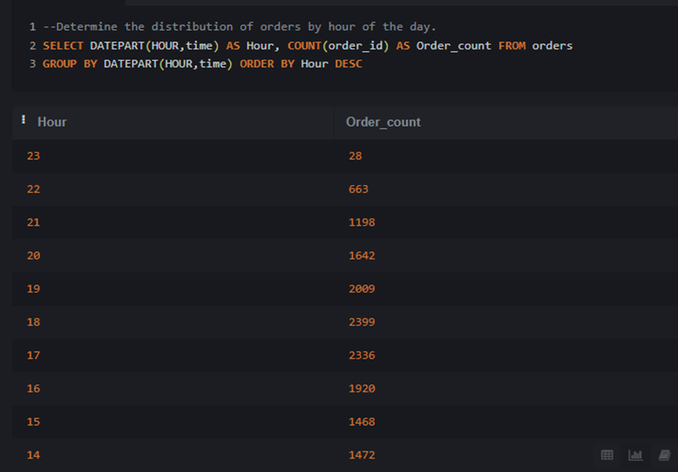
DETERMINE THE DISTRIBUTION OF ORDERS BY HOUR OF THE DAY.
select DATEPART(HOUR,time) as Hour, count(order_id) as Order_count from orders
group by DATEPART(HOUR,time) order by Hour desc

Slide 10
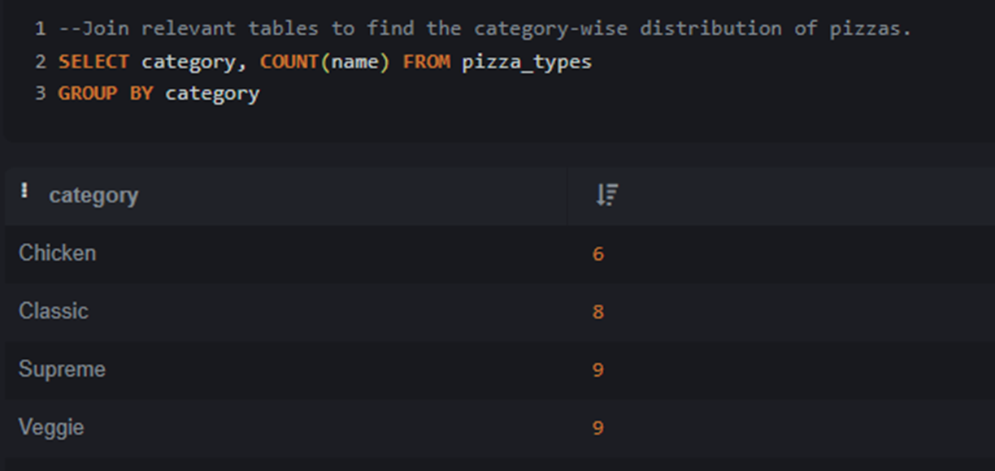
JOIN RELEVANT TABLES TO FIND THE CATEGORY-WISE DISTRIBUTION OF PIZZAS.
Select category, count(name) from pizza_types
group by category

Slide 11
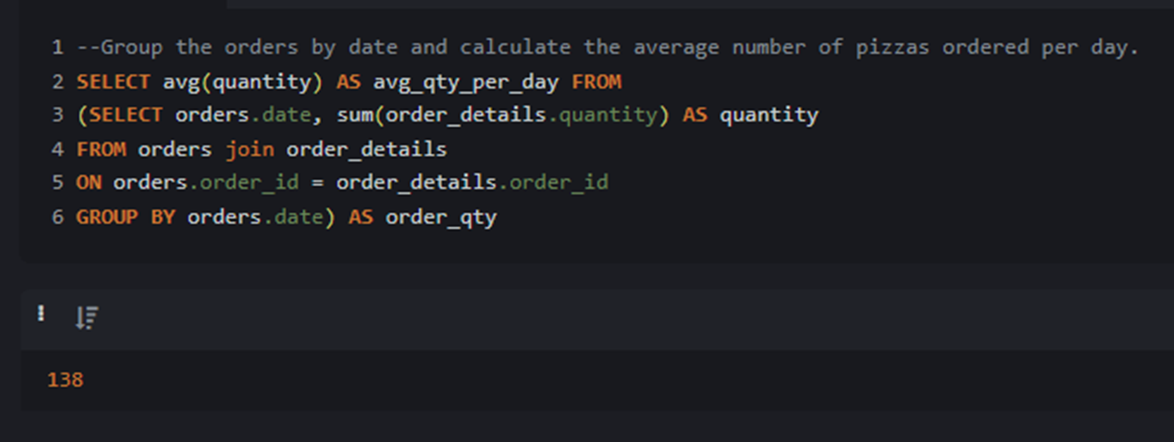
GROUP THE ORDERS BY DATE AND CALCULATE THE AVERAGE NUMBER OF PIZZAS ORDERED PER DAY.
select avg(quantity) as avg_qty_per_day from
(Select orders.date, sum(order_details.quantity) as quantity
from orders join order_details on orders.order_id = order_details.order_id
group by orders.date) as order_qty

Slide 12
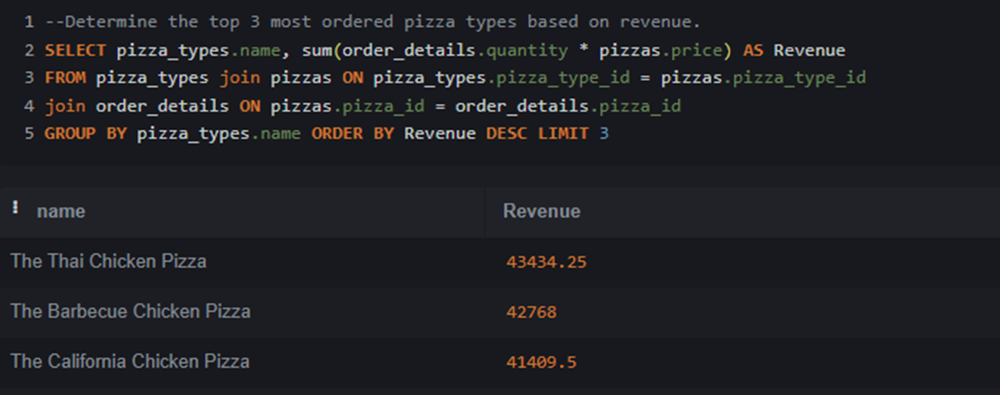
DETERMINE THE TOP 3 MOST ORDERED PIZZA TYPES BASED ON REVENUE.
select pizza_types.name, sum(order_details.quantity * pizzas.price) as Revenue
from pizza_types join pizzas on pizza_types.pizza_type_id = pizzas.pizza_type_id
join order_details on pizzas.pizza_id = order_details.pizza_id
group by pizza_types.name order by Revenue desc LIMIT 3

Slide 13
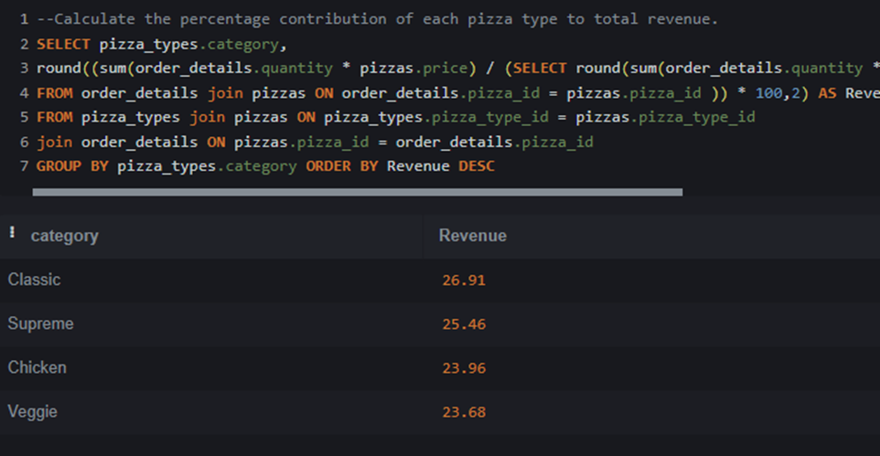
CALCULATE THE PERCENTAGE CONTRIBUTION OF EACH PIZZA TYPE TO TOTAL REVENUE.
select pizza_types.category,
round((sum(order_details.quantity * pizzas.price) / (SELECT round(sum(order_details.quantity * pizzas.price),2) as total_revenue from order_details join pizzas on order_details.pizza_id = pizzas.pizza_id )) * 100,2) as Revenue
from pizza_types join pizzas on pizza_types.pizza_type_id = pizzas.pizza_type_id
join order_details on pizzas.pizza_id = order_details.pizza_id
group by pizza_types.category order by Revenue desc

Slide 14
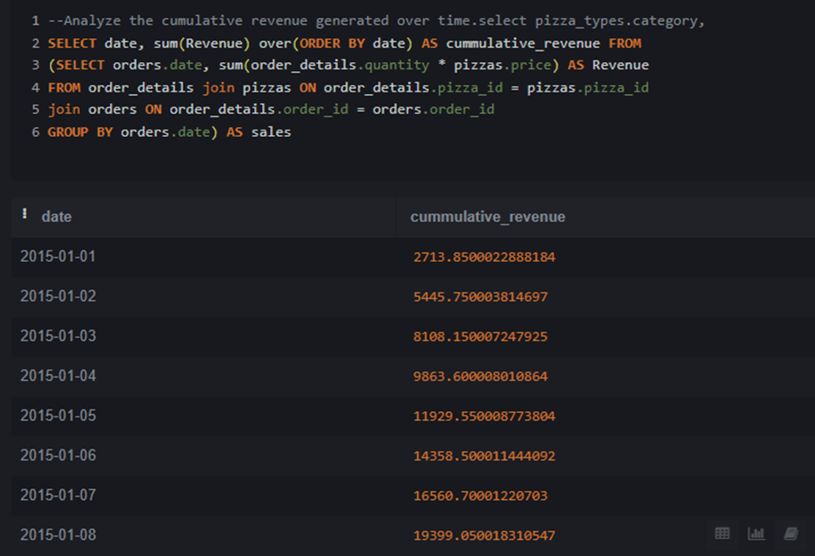
ANALYZE THE CUMULATIVE REVENUE GENERATED OVER TIME.
select date, sum(Revenue) over(order by date) as cummulative_revenue from
(select orders.date, sum(order_details.quantity * pizzas.price) as Revenue
from order_details join pizzas on order_details.pizza_id = pizzas.pizza_id
join orders on order_details.order_id = orders.order_id
group by orders.date) as sales

Slide 15
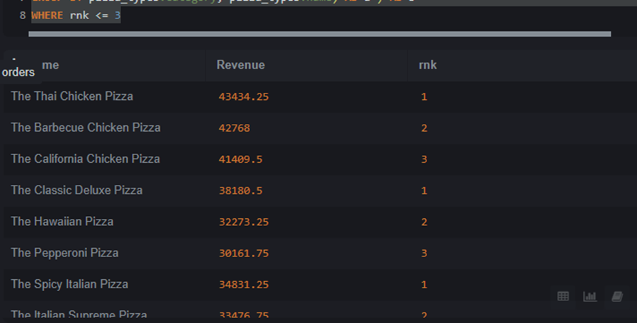
DETERMINE THE TOP 3 MOST ORDERED PIZZA TYPES BASED ON REVENUE FOR EACH PIZZA CATEGORY.
select Name, Revenue, rnk from
(select category, name, revenue, rank() over(partition by category order by revenue desc) as rnk from
(select pizza_types.category, pizza_types.name, sum(order_details.quantity * pizzas.price) as Revenue
from order_details join pizzas on order_details.pizza_id = pizzas.pizza_id join pizza_types on pizza_types.pizza_type_id = pizzas.pizza_type_id group by pizza_types.category, pizza_types.name) as a ) as b where rnk <= 3

Slide 16
Pizza Resto Presentation
THANK YOU
FOR ATTENTION

